Slide 1
Access Modifiers in C# and understanding of assembly
1. public, 2. private, 3. protected,4. internal, 5. protected internal,6. private protected

Slide 2
What is Access Modifiers
. public
protected
internal
protected internal
private
There are 4 access modifiers (public, protected, internal, private) which defines the 6 accessibility levels as follows.
Definition: Access Modifiers are keywords that define the accessibility of a member, class or datatype in a program. These are mainly used to restrict unwanted data manipulation by external programs or classes.

Slide 3
All definition's
Public : The type or member can be accessed by any other code in the same assembly or another assembly that references it.
Private : The type or member can be accessed only by code in the same class or struct
Protected: The type or member can be accessed only by code in the same class or in a class that is derived from that class
Internal : The type or member can be accessed by any code in the same assembly, but not from another assembly.
Protected internal : The type or member can be accessed by any code in the assembly in which it's declared, or from within a derived class in another assembly.

Slide 4
What is assembly in c#
In the Microsoft . NET framework, an assembly is a partially compiled code library for use in deployment, versioning and security. There are two types: process assemblies (EXE) and library assemblies (DLL). A process assembly represents a process which will use classes defined in library assemblies
Or Assembly is the smallest unit of deployment of a .net application. It can be a dll or an exe. There are mainly two types to it:
1. Private Assembly: The dll or exe which is sole property of one application only. It is generally stored in application root folder
2. Public/Shared assembly: It is a dll which can be used by multiple applications at a time. A shared assembly is stored in GAC
Note 1. GAC MEANS : C:\Windows\Assembly folder where you can find the public assemblies/DLLS of all the software's installed in your PC.

Slide 5
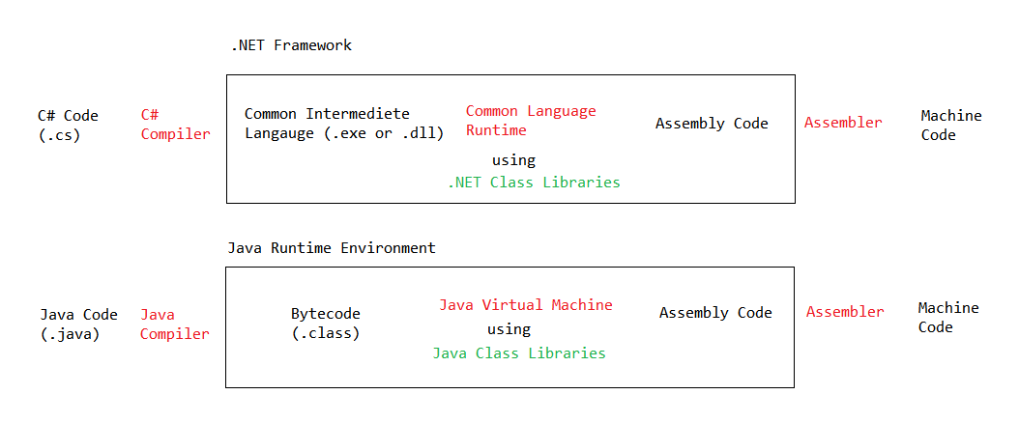
FOR more understanding

